Slide 1
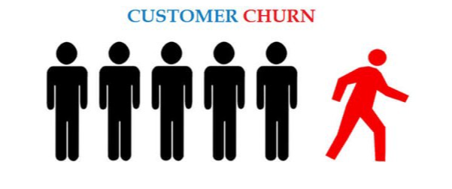
Customer Churn Analysis
An Exploratory Data Analysis (EDA) with Machine Learning Insights
Project Overview
-Exploratory Data Analysis (EDA)
-Model Building
-Insights and Recommendations
Presented by:
Christos Sachpazis, Konstantinos Kamarakis, Giannis Angelidakis

Slide 2
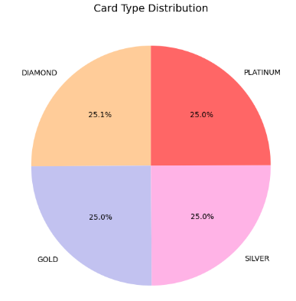
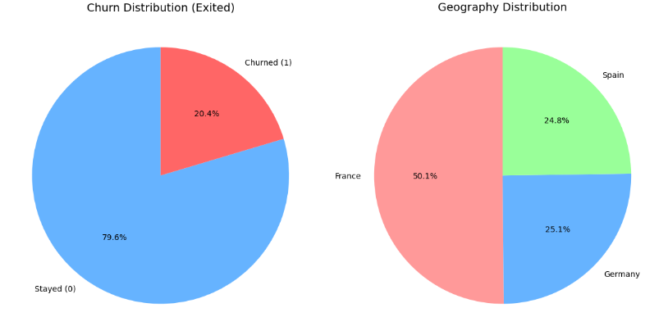
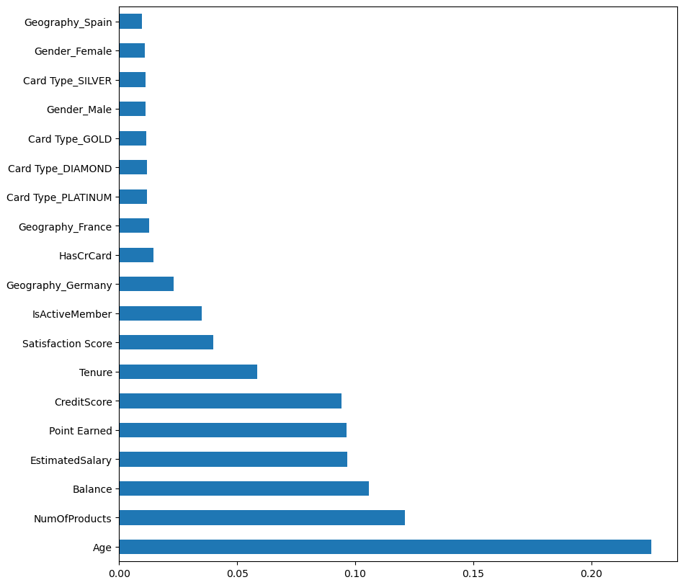
Data Overview
-10.000 Customers
-4 type of cards
Key Features:
Demographic:Age,Gender,
Country
Account Info:
Balance, Tenure, Products
Customer Status:
Credit Score, Satisfaction,
Complaint status
Target Variable: EXITED

Slide 3
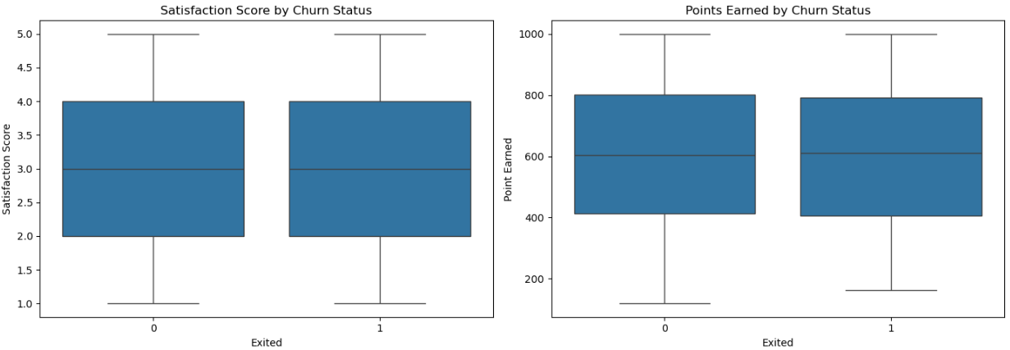
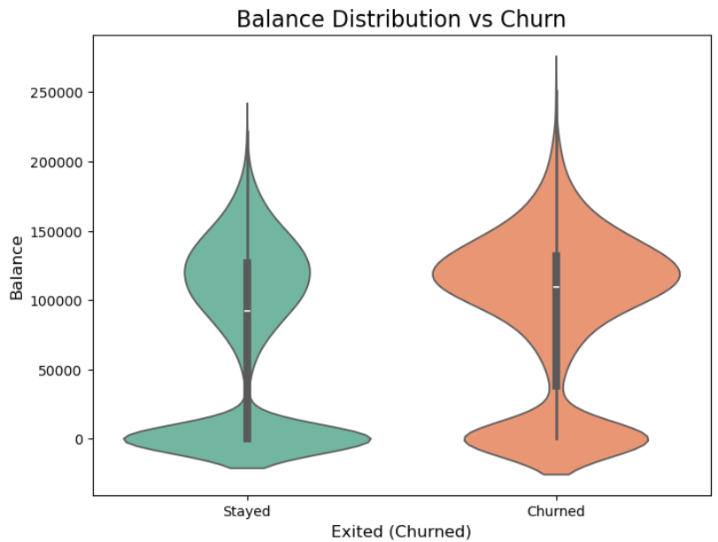
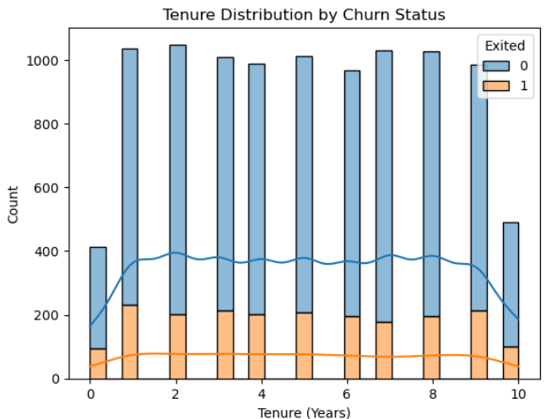
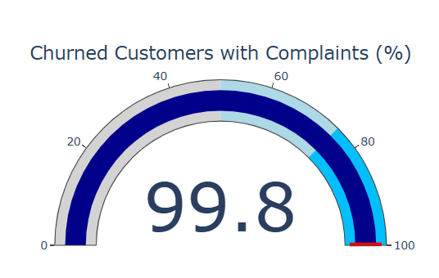
Every customer with a complaint —>exit
Least significant features:
-Satisfaction score
-Points earned
-Balance
-Tenure

Slide 4
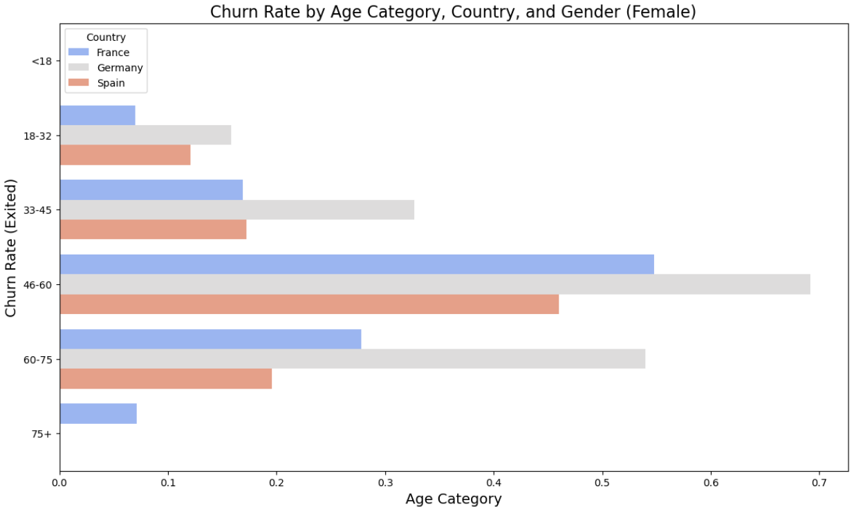
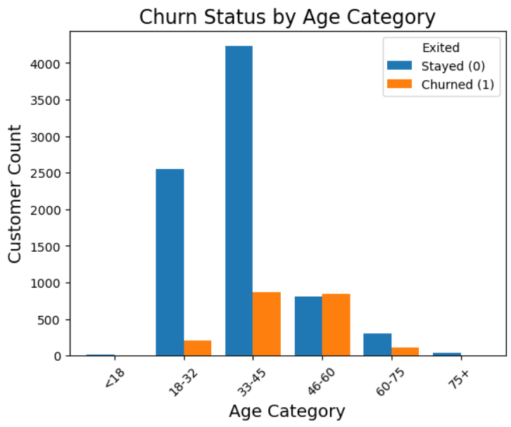
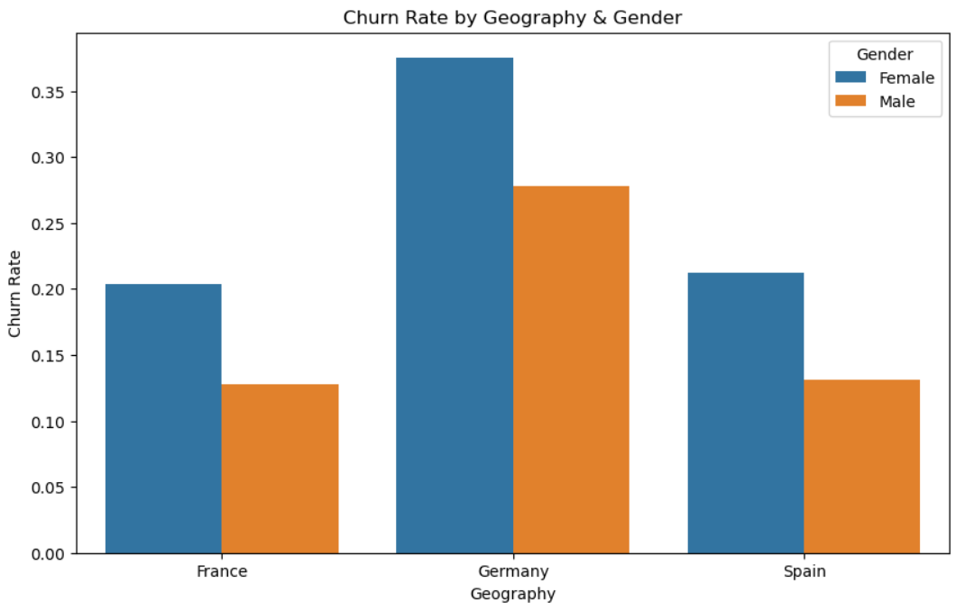
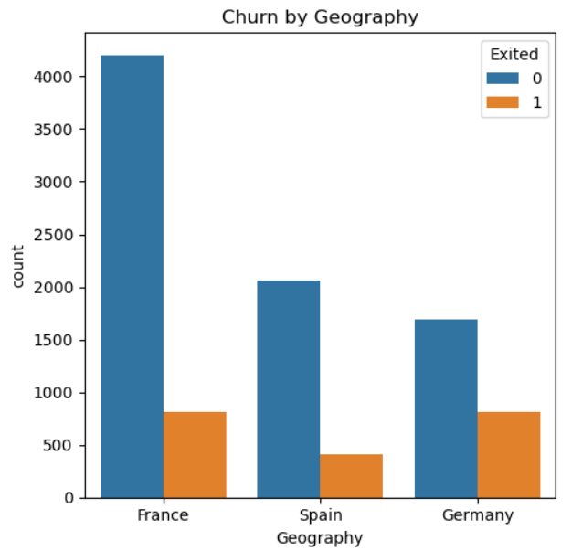
EDA visualizations

Slide 5
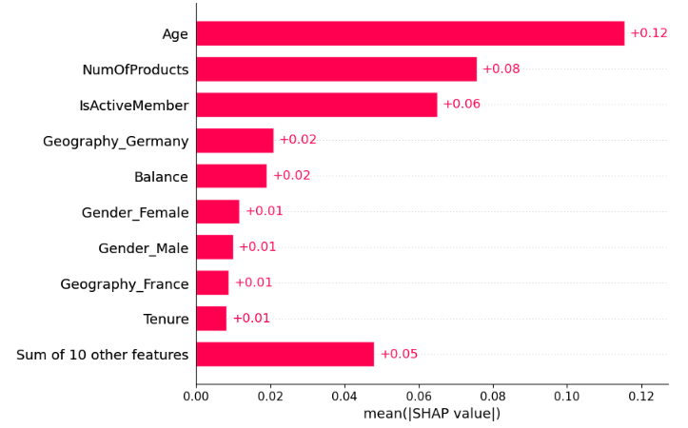
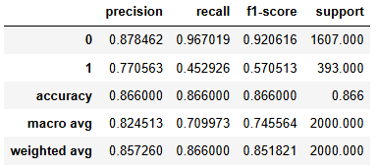
Run - Results for raw Dataset (cleaned)
Multiple methods were used to predict the churn values from the Dataset (without balancing at first). Results by the best model (and parameters) are as follows:

Slide 6
How accurate are we?
Trade-offs!
1st Method
Good at finding our loyal Customers!
2nd Method
Excellent at finding our customers that we can make happier
3rd Method
Good at both - excellent at neither!
Three different methods of balancing the data
Compared between eight different predicting algorithms
More than 24 different models produced!

Slide 7
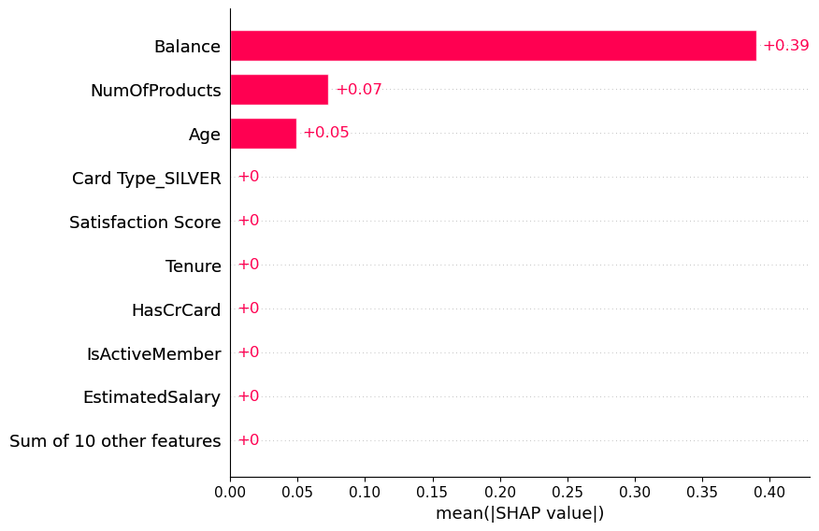
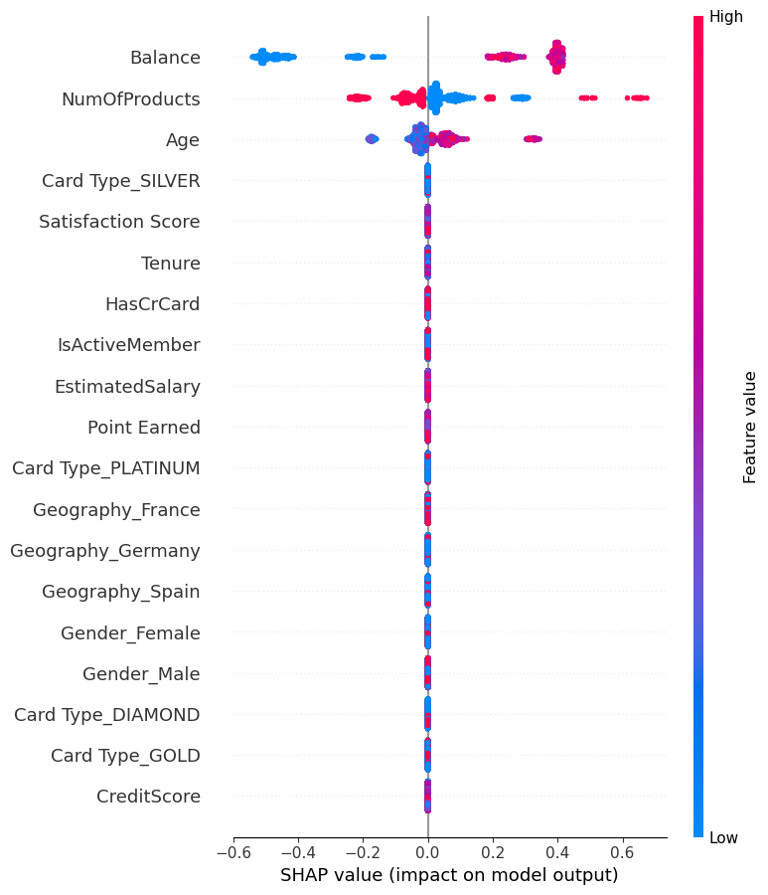
1st Proposition
Training for higher accuracy to detect the ones leaving
9 out of 10
Trade off
Not very accurate on whose staying

Slide 8
Younger people
People with small balances
Not having many products

Slide 9
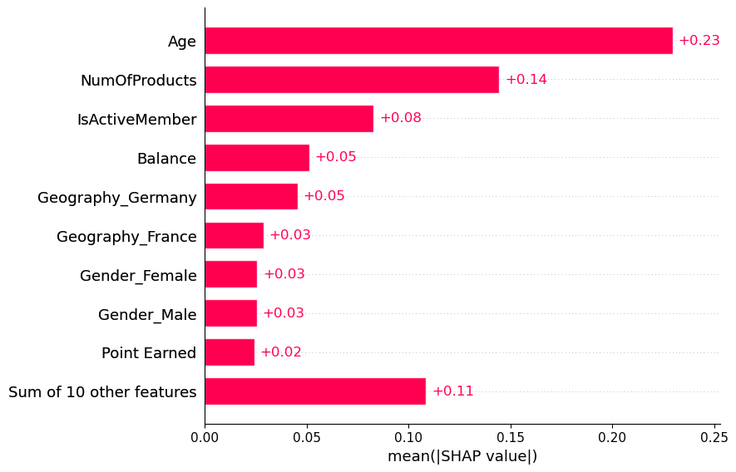
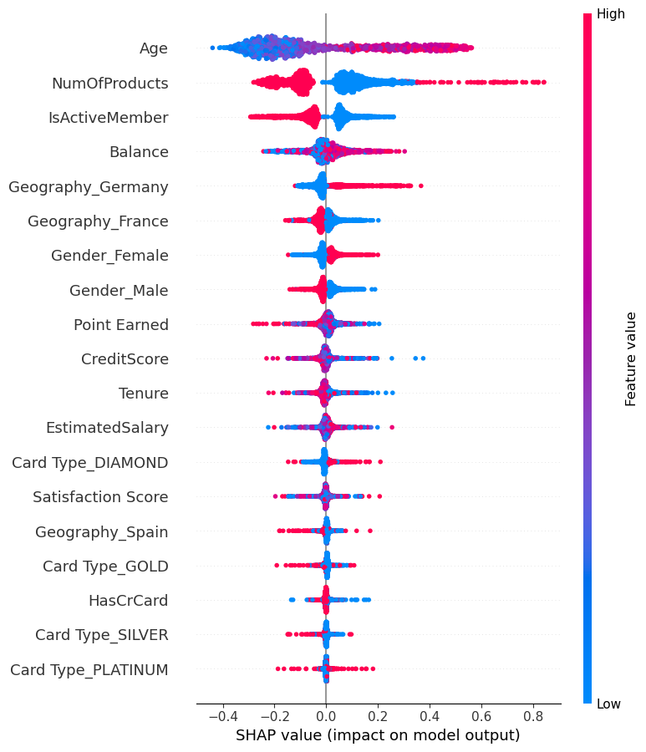
2nd Proposed Method
Predicts correctly 77 out of 100 who’s leaving
Predicts correctly
79 out of 100 who’s staying
How expensive will a Targeted Campaign be?

Slide 10
Younger people
People with small balances
Not having many products
Not the Spaniards!!

Slide 11
Something to consider!
Campaign with bank products targeted to young people will help lowering the churn rate
Mainly to our German and French Customers
Investigation on the type and time of complaints
Investigate ways of addressing these complaints

